Slide 1



Project Title: InsurAI – Corporate Policy Automation and Intelligence System
MILESTONE 2
Presented By
Anushka Dutta

Slide 2
Introduction
Problem Statement
Objective
Large companies provide multiple insurance policies to their employees (e.g., health, accident, corporate benefits). Today, most of this work is managed by HR departments and insurance agents manually. This leads to:
To design and build an automated, intelligent corporate insurance management system that:
Simplifies policy management.
Delays in claim approval.
Speeds up claim approvals.
Errors due to human processing.
Enhances transparency for employees.
Lack of transparency for employees.
Reduces fraud through AI-based detection.
Increased administrative costs.
Provides insights to HR and Admins.
Higher chances of fraud going undetected.
Scope
Designed for corporates (not for individual policy buyers).
Supports role-based access: Employee, Agent, HR Admin, System Admin.
Core functions include: policy renewals, claim approvals, tax compliance, reporting, fraud detection, and analytics.
Can scale for large organizations with thousands of employees.

Slide 3

Existing System (Current Practices)
Manual Submission
Employees submit forms manually or via email.
No Tracking
Employees cannot track the status of their claims in real-time.
Manual Verification
HR and Agents manually verify documents and eligibility.
No Fraud Detection
No proper fraud detection → companies lose money on false claims.
Delayed Claims
Claims are often delayed due to paperwork and communication gaps.

Slide 4

Proposed System – InsurAI Solution
A web-based insurance management platform with automation and intelligence.
Core Features
Role-based logins (Employee, Agent, HR, Admin).
AI & Analytics
Fraud detection: flagging duplicate claims, unusually high amounts, and suspicious patterns.
Predictive insights for HR/Admins.
Automation
Transparency
Auto policy renewals.
Employees can track claims and policies in real time.
Automatic claim eligibility checks.
Auto-generated reports (weekly, monthly, yearly).
Automated notifications and reminders (email/SMS).
Automated tax rule application.

Slide 5





System Users & Roles
Employee
Agent
Register/login
Manage employee queries
View policy details
Update availability
Submit claims
Assist employees in claim process
Upload documents
Track status
HR Admin
System Admin
Add employees
Manage all roles
Approve/reject claims
Assign permissions
Manage policies
Configure tax rules
Generate reports
Monitor fraud detection

Slide 6

System Features
01
02
Authentication & Registration
Employee Portal
Secure login for Employees, Agents, HR, and Admin.
Submit claims.
JWT-based authentication with role-based access control.
Upload supporting documents.
Track claim status in real time.
03
View insurance policies & benefits.
Agent Management
Agents register and set availability.
Employees can request support from agents.
Agent dashboard to track pending queries.
04
HR Dashboard
Manage employee insurance data.
Approve/reject claims.
Generate scheduled reports (monthly/yearly).
Review fraud alerts generated by AI.

Slide 7

System Features (Continued)
05
06
Admin Dashboard
Automation
Manage all system roles.
Auto-reminders for policy renewals.
Set tax rules, permissions, and company-wide policies.
Auto-checks for claim eligibility.
Oversee fraud detection alerts and system health.
Scheduled reporting to HR/Admin.
Configure automation rules.
07
AI Intelligence
Fraud detection via anomaly detection (flagging duplicates, large unusual claims).
Predictive analytics for HR (policy usage trends, employee health claim patterns).
08
Reports & Analytics
PDF/Excel reports for claims, fraud alerts, policy usage.
Visual dashboards (charts, graphs).
Downloadable audit logs.

Slide 8

Modules Breakdown
Login & Registration Module
Secure entry, JWT authentication.
Claim Management Module
Raise claims, upload docs, auto-rule checks, HR approval/rejection.
Admin Dashboard Module
Role management, tax rules, fraud alerts, audit logs.
Policy Management Module
Add/update/view company insurance policies.
Agent Management Module
Availability tracking, employee-agent interaction.
Reports & Analytics Module
Automated reporting, fraud insights, visual dashboards.

Slide 9

Technology Stack
Backend
Database
Java Spring Boot (scalable, secure, enterprise-ready).
MySQL / PostgreSQL (structured insurance & user data) and Superbase for file storage
Frontend
Authentication
React.js (modern, responsive UI).
JWT (secure token-based login).

Slide 10
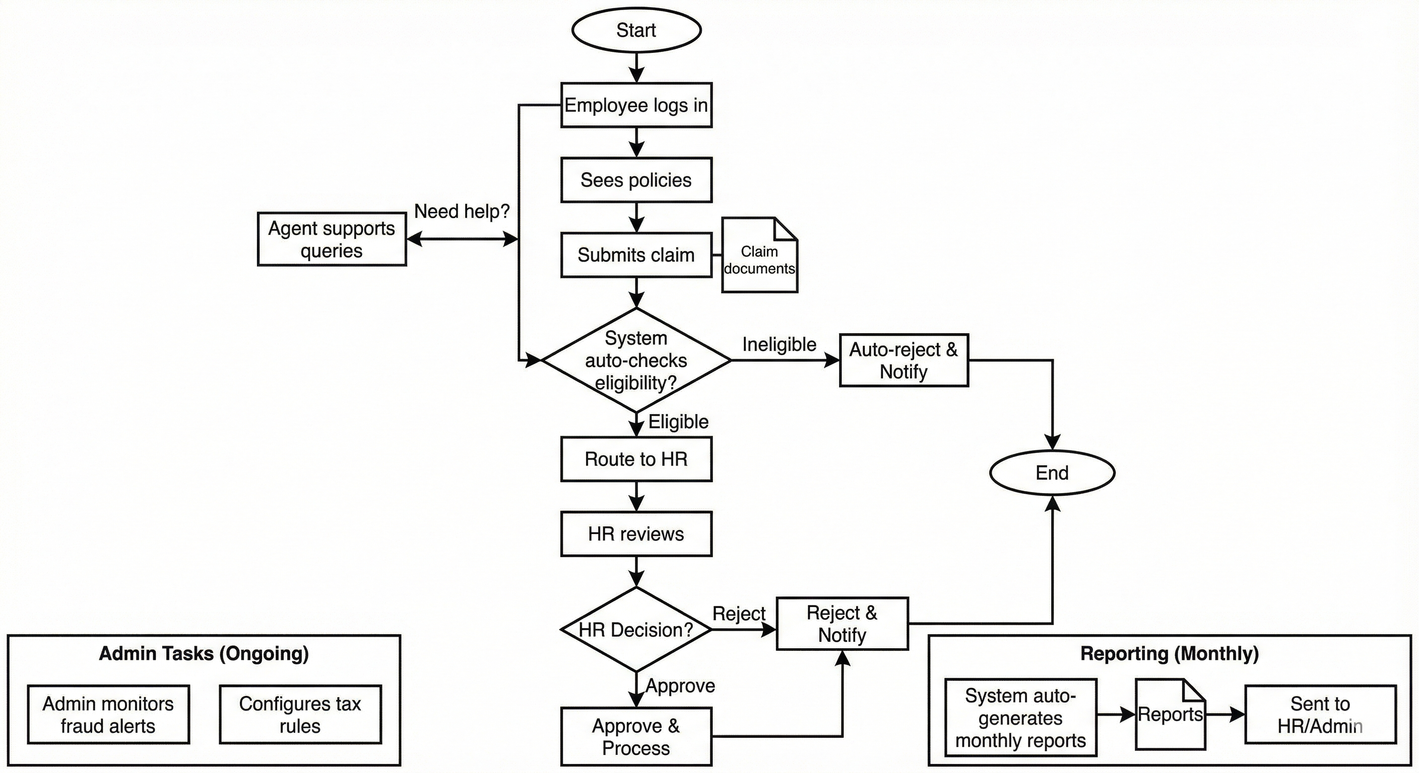
Workflow Example
Employee Login & Policy View
Employees securely log in and access their available insurance policies.
Claim Submission
Employees can easily submit new claims and upload supporting documents.
Auto-Eligibility Check
The system automatically verifies claim eligibility based on policy rules.
HR Review & Decision
Eligible claims are routed to HR for review, approval, or rejection.
Agent Support (if needed)
Agents are available to assist employees with any queries during the process.
Auto-Generated Reports
Monthly reports on claims and policy usage are automatically generated and sent to HR/Admin.

Slide 11





Advantages
For Employees
For HR
Transparency, faster claims, real-time updates.
Reduced workload, automated reporting.
For Admins
For Company
Strong system control, fraud detection, compliance.
Reduced costs, better trust, scalable solution.
Limitations
Web-Only Platform
Currently accessible via web browsers only; mobile app development is a future consideration.
Rule-Based Fraud Detection
Fraud detection relies on predefined rules; advanced AI/ML models are planned for improved accuracy.
Limited External Integration
No direct integration with external insurance companies or hospitals implemented yet.

Slide 12

Future Scope
Mobile App Development
AI Chatbot for Support
Launch of Android/iOS mobile applications for enhanced employee access and convenience.
Introduction of an intelligent AI chatbot to handle employee queries and provide instant assistance.
External System Integration
Blockchain for Security
Direct integration capabilities with insurance providers and hospital systems for seamless data exchange.
Implementation of blockchain technology for secure, immutable tracking of claim histories.
Cloud Deployment
Transition to a robust cloud infrastructure (AWS/Azure) to support large-scale enterprise usage and scalability.

Slide 13

Conclusion
The InsurAI – Corporate Policy Automation and Intelligence System is a complete enterprise-grade solution for corporate insurance management. It combines automation, role-based access, reporting, and AI intelligence to improve efficiency, reduce fraud, and empower employees with transparency and self-service tools.
The system is scalable, secure, and future-ready, making it suitable for medium to large corporates aiming to modernize their insurance policy management.

Slide 14


